Slide 1
MAJOR PROJECT IMPLEMENTATION OF BLOCKCHAIN IN FINANCIAL SECTOR TO IMPROVE SCALABILITY
Under the guidance of:
Dr. H. Parthasarathi Pathra
Associate Professor and
Department of C.S.E
GVP College of Engineering(A)
By
N.Srikar---19131A05G1
P.Divyagandh---19131A05H7
P. Hema Harsha Vardhan---19131A05H4
Nitin Ancha---19131A05G0
CSE - 3

Slide 2
ABSTRACT
The Blockchain is an encrypted database that stores information statistics, or in different words, it is a virtual ledger of any transactions, contracts - that needs to be independently recorded.
One of the key capabilities of Blockchain is that this virtual ledger is out there throughout several masses and heaps of computer and isn't always sure to be stored in a single place.
The aim of the project is to conduct research on the effect of blockchain technology on the financial sector. There is no doubt that the world is curious to see how this promising technology will influence or shape the future of banking. Blockchain enhances safety in data storage and transmutation, avails a decentralized and transparent network infrastructure and significantly reduces the costs in operations.
These remarkable attributes make blockchain a very promising and in-demand solution even in an industry as restricted as the banking sector.

Slide 3
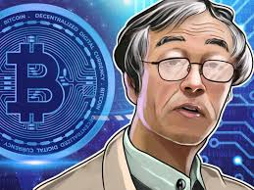
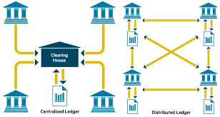
INTRODUCTION
A blockchain is a distributed digital ledger where transactions can be recorded and checked electronically over a network of computers in the absence of a central ledger. Cryptography is used to protect the data from deception or hackers[1].
It was invented by “Satoshi Nakamoto” in 2008. A blockchain helps to record all the transactions made so that no alterations can be made later on so as to maintain the security of the data.
The duplicated shared ledger concept in blockchain technology can help remove these weaknesses[2].
The execution of blockchain will empower pointless arbiters to be relinquished and give clients and banks less expensive administrations.

Slide 4
EXISTING SYSTEM AND IT’S DRAWBACKS
There this record book shows every transaction that has ever happened in chronological order and we each hold an exact copy of it because of the way the pages are bound together trying to go back and change past trades would be practically impossible and because we each hold a copy of it we would know if something went wrong, this shared record book is essentially a blockchain.
A blockchain is a distributed, immutable ledger or record of transactions. Distributed means that it’s shared and stored in multiple locations removing a single point of failure and providing perceptibility across massive participants. Immutable means that it’s nearly impossible to go back and change the past records once they have been agreed by and attach using cryptography.
Less accuracy
low Efficiency
Difficulty in tracking previous transactions

Slide 5
PROPOSED SYSTEM
Nevertheless closely reliant and dependent on paper, despite the fact that dressed up with a virtual appearance, there are various problems with this era.
In spite of the monetary employer’s resistance to trade, blockchain and its anticipated benefits make it worthwhile. Blockchain, not like traditional structures, is dynamic enough to come to be a pacesetter in implementation in a chargeable market situation.
In a blockchain, the best advantage it guarantees is that every celebration has a report that is maintained in a ledger to be had to everyone.
It is a ledger extensively surpassed between special users thereby developing a shared database that is replicated to those users and who can get right of entry to it simplest when they have the get admission to the right for it.

Slide 6
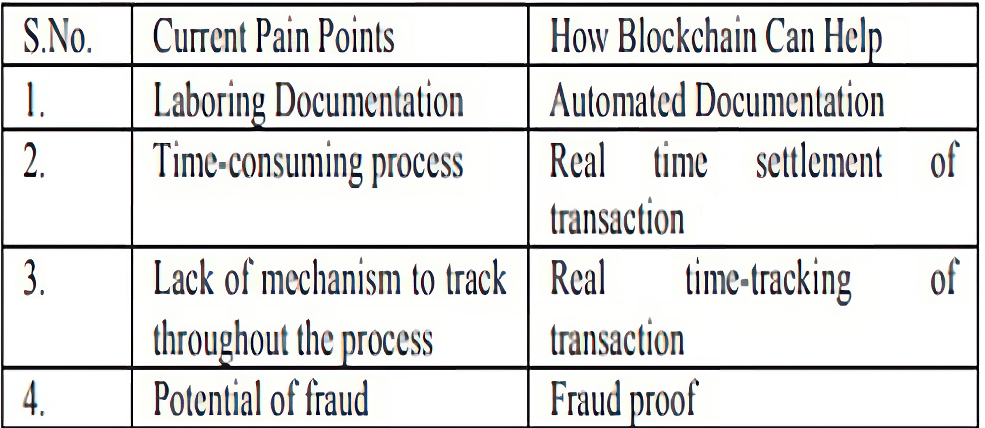
ADVANTAGES OF PROPOSED SYSTEM
High accuracy
High efficiency
On-chain settlement
Low transfer fees
24*7 Availability
Transparency
Table 1. Easy Payment through Blockchain

Slide 7
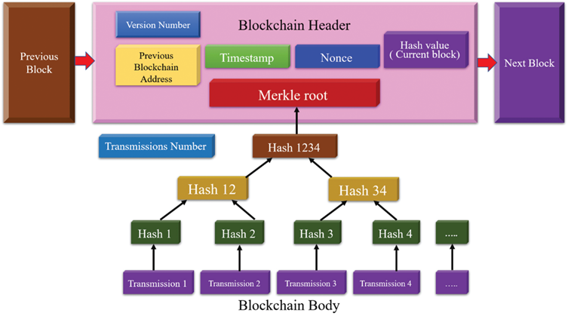
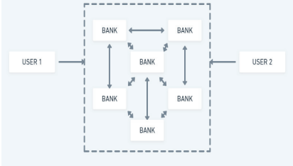
BLOCK DIAGRAM AND GRAPHICAL REPRESENTATION

Slide 8
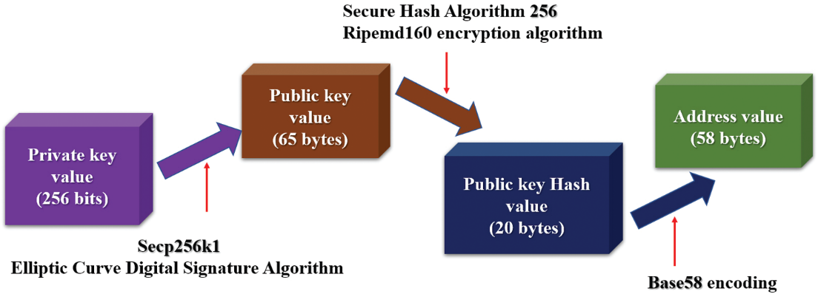
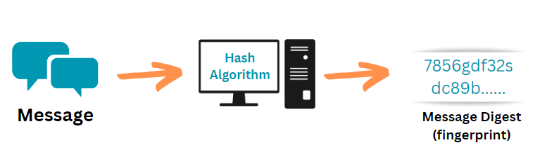

Slide 9
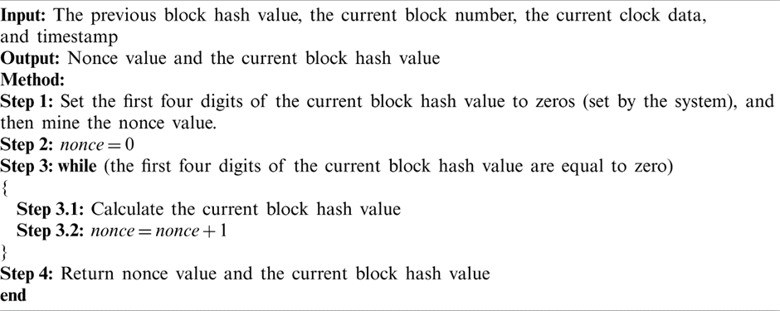
ALGORITHM

Slide 10
HARDWARE REQUIREMENTS
SOFTWARE REQUIREMENTS
MODULES USED IN PROJECT
System : i3 or above
Ram : 4GB Ram.
Hard disk : 40GB
Django
Web3
Operating system : Windows
Coding Language : Python

Slide 11
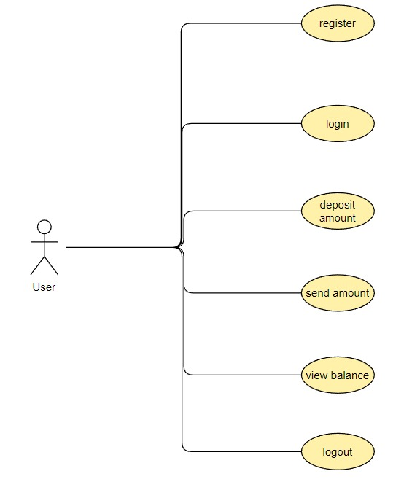
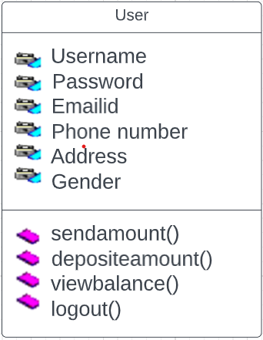
UML DIAGRAMS
Use case Diagram
Class Diagram

Slide 12
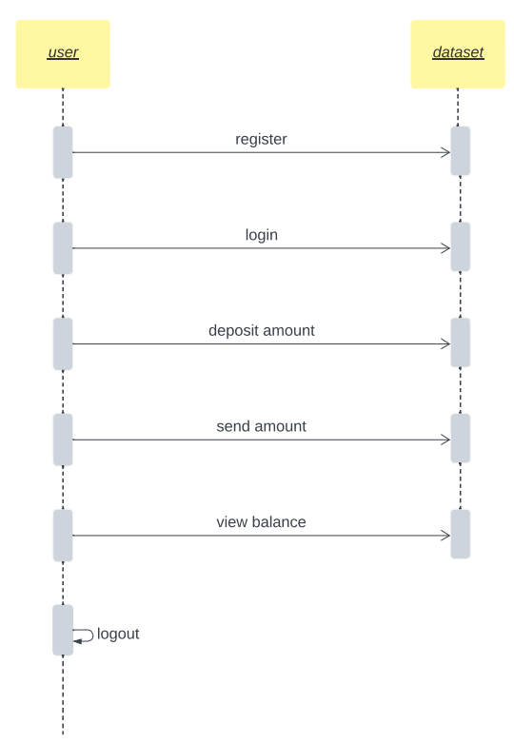
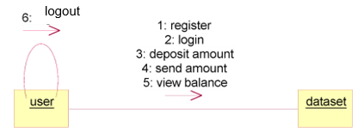
UML DIAGRAMS
Collaboration Diagram
Sequence Diagram

Slide 13
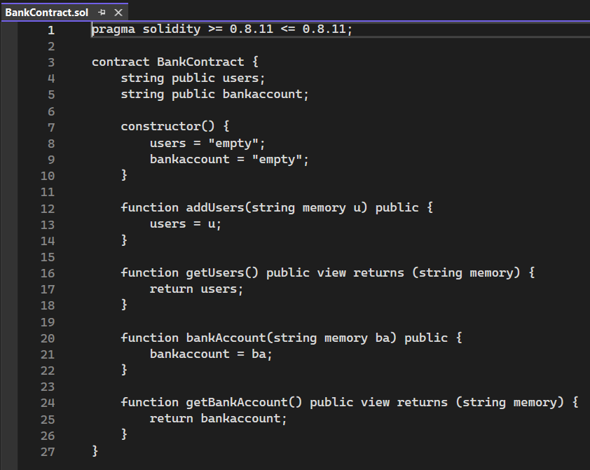
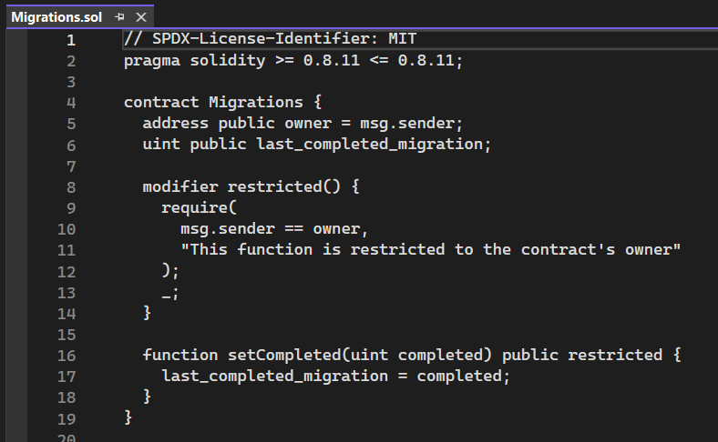
IMPLEMENTATION

Slide 14
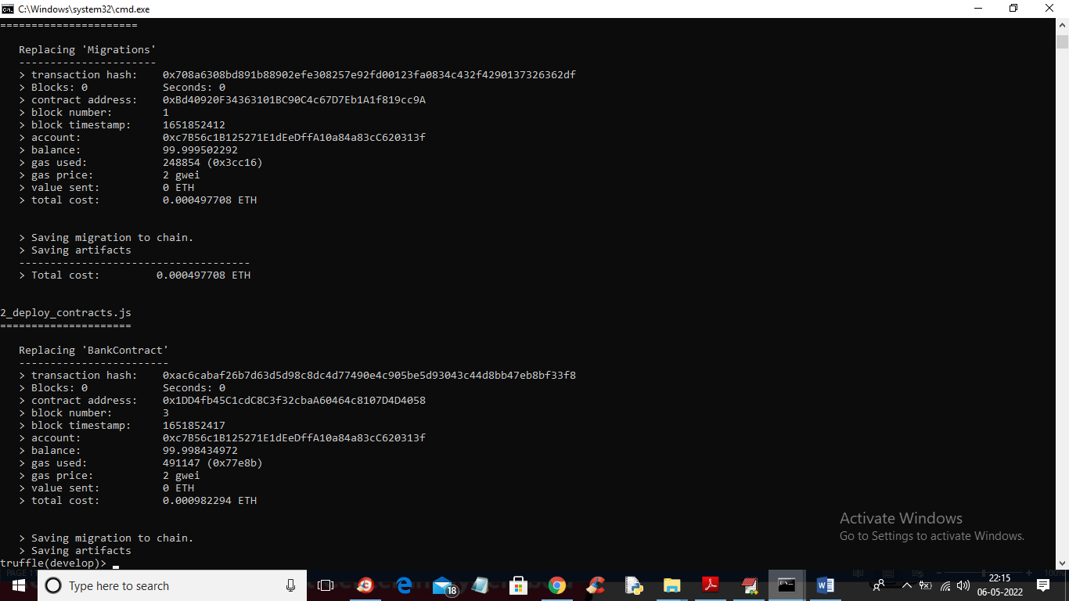
Implementation
Similarly you can create N users and send money which running code TRUFFLE ETHEREUM tool and DJANGO SERVER must be running and this server I am showing below screen

Slide 15
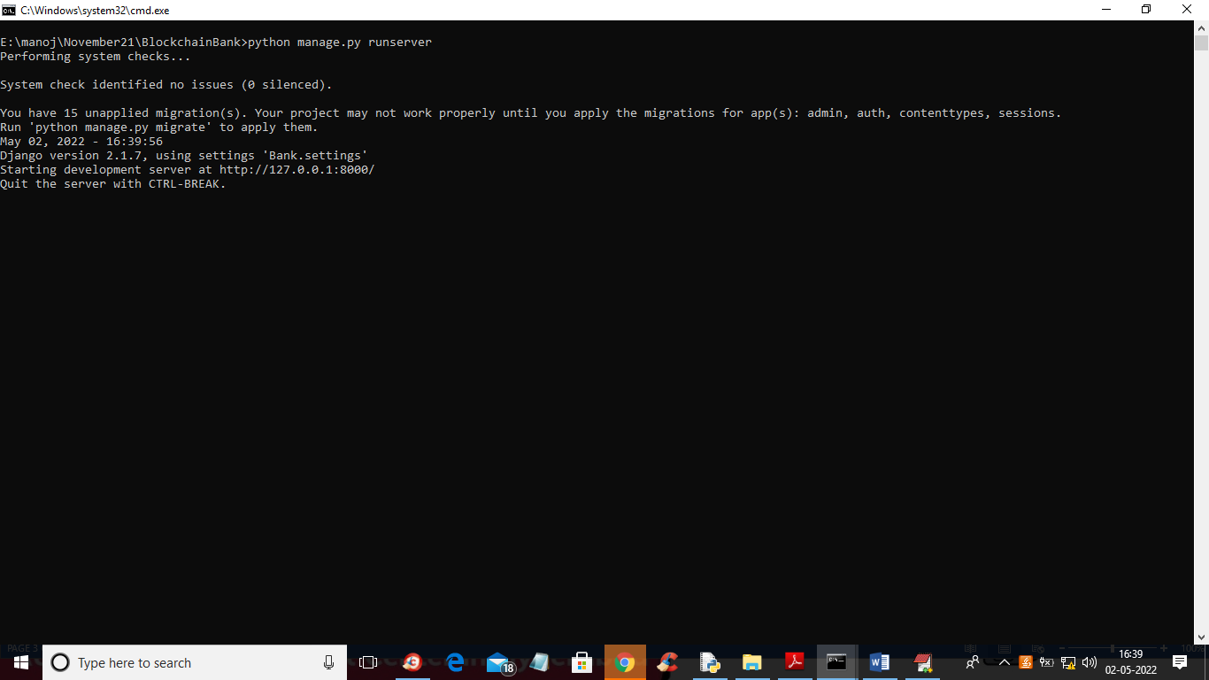
IMPLEMENTATION
Double click on ‘run.bat’ file to start ‘DJANGO’ web server like shown in the below screen
DJANGO has server started and now the server can be accessed at http://127.0.0.1:8000/index.html

Slide 16
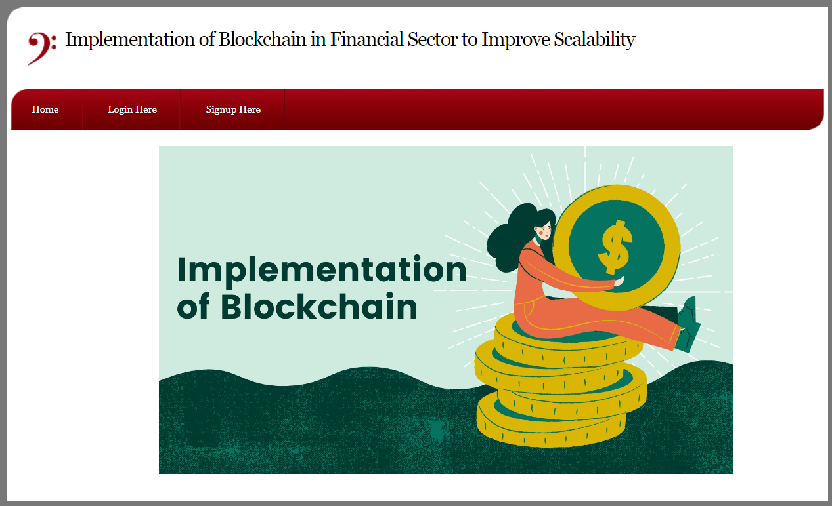
OUTPUT screens
Home Screen:

Slide 17
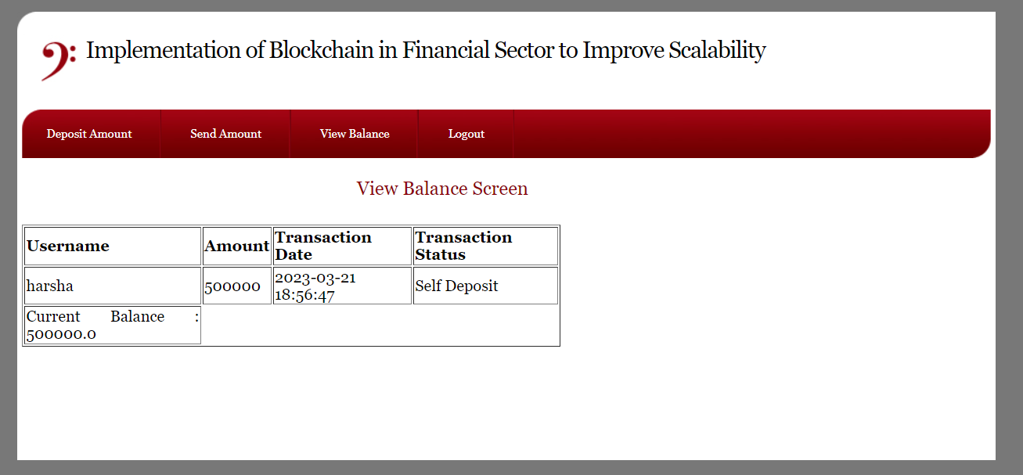
Sender’s Balance sheet

Slide 18
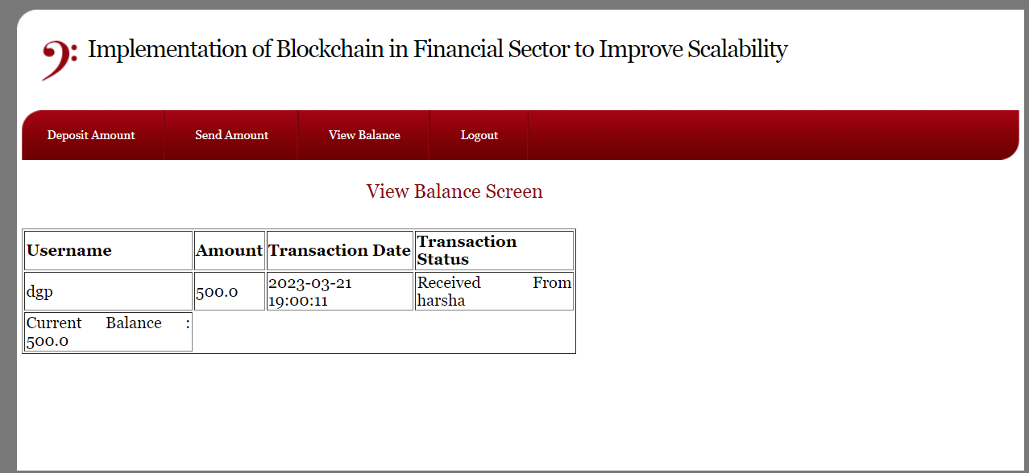
Receiver’s balance sheet

Slide 19
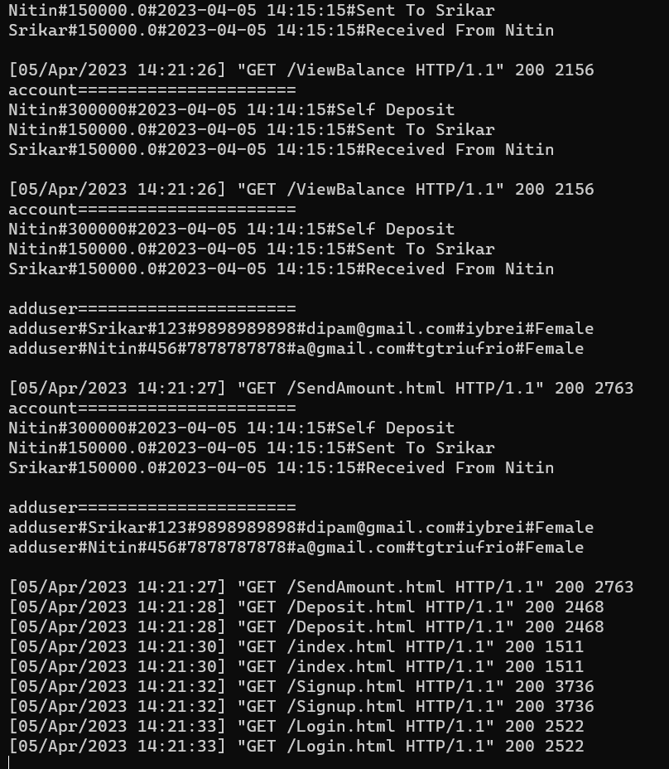
Representation of Blocks

Slide 20
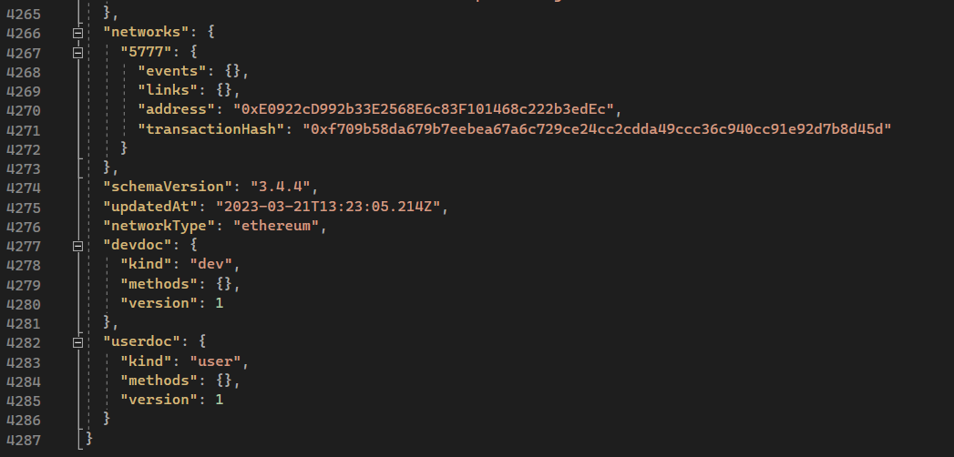
Json file
Used for Serializing structured data and exchanging it over a network mainly between a server and a web application

Slide 21
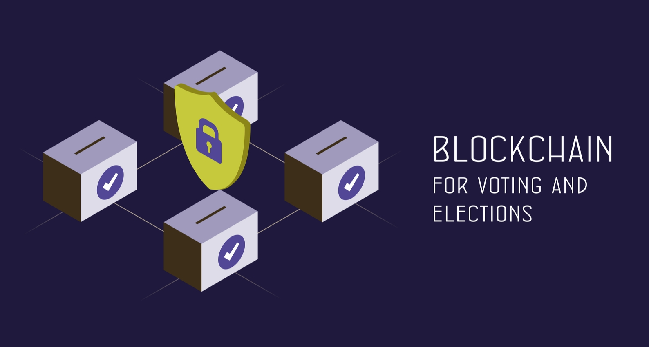
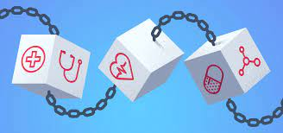
CONCLUSION
Blockchain technology has the potential to greatly improve scalability in the financial sector.
By utilizing a decentralized and secure system, blockchain can increase efficiency and reduce costs and also reduce the risk of fraud
Blockchain can result in significant cost savings for both businesses and consumers.
Looking to the future, blockchain technology has the potential to play an increasingly important role in the financial sector.
The global blockchain market is expected to be worth $1,431.54 billion by 2030, growing at a CAGR of around 85.9% from 2022-2031.

Slide 22
REFERENCES
[1] Saah, Shalilak Jani, “Applications of Blockchain Technology in banking and finance”, Parul University, Vadodara, India, February 2018 DOI: 10.13140/RG.2.2.35237.96489
[2] DUSKO KNEZEVIC, “Impact of blockchain technology platform in changing the financial sector and other industrutries., University Union Belgrade, Serbia, Montenegrin Journal Of Economics, Vol. 14, No. 1(2018), p.p(109-120).

Slide 23
Thank you

